Slide 1
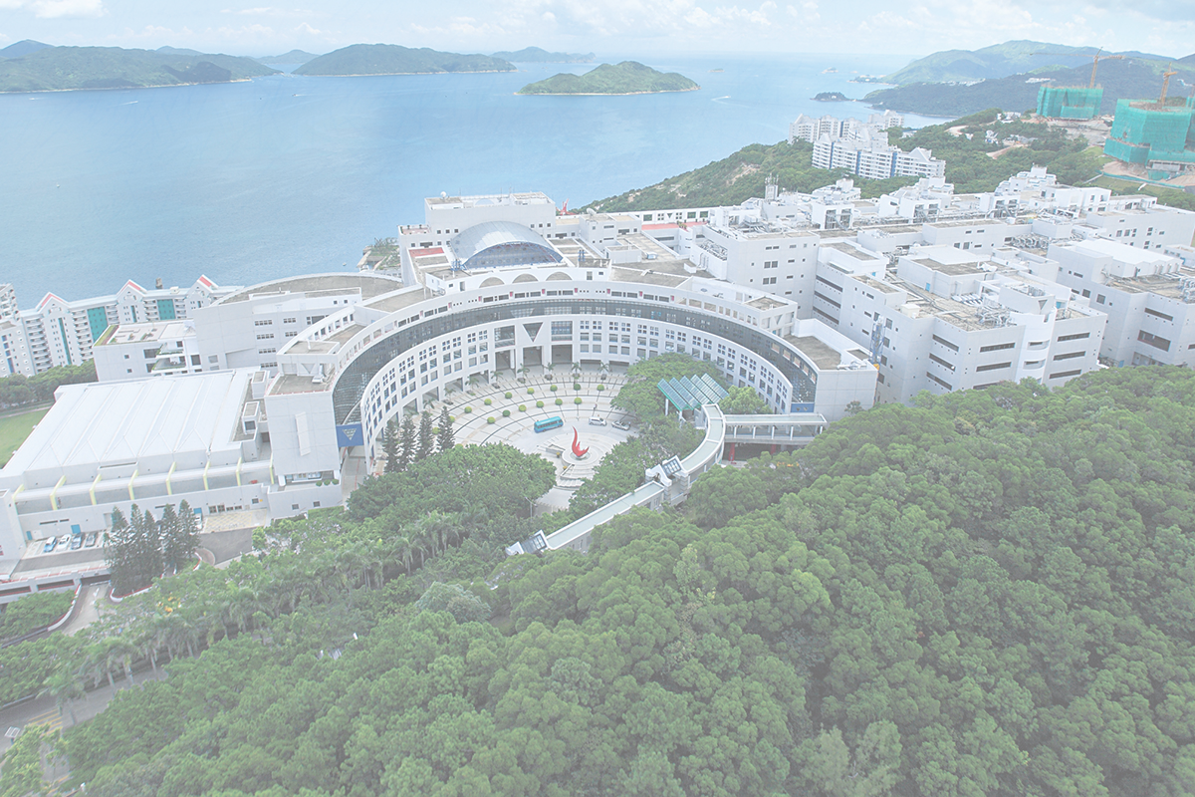

Deep learning methods for movie recommendation system
Group member ：
HUANG Yitian JIANG Yuxin SONG Di
YUAN Yanzhe LOU Yuqi WEN Ze
Notes:
Good evening,I am huangyitian. Our project is deep learning methods for movie recommendation system.

Slide 2

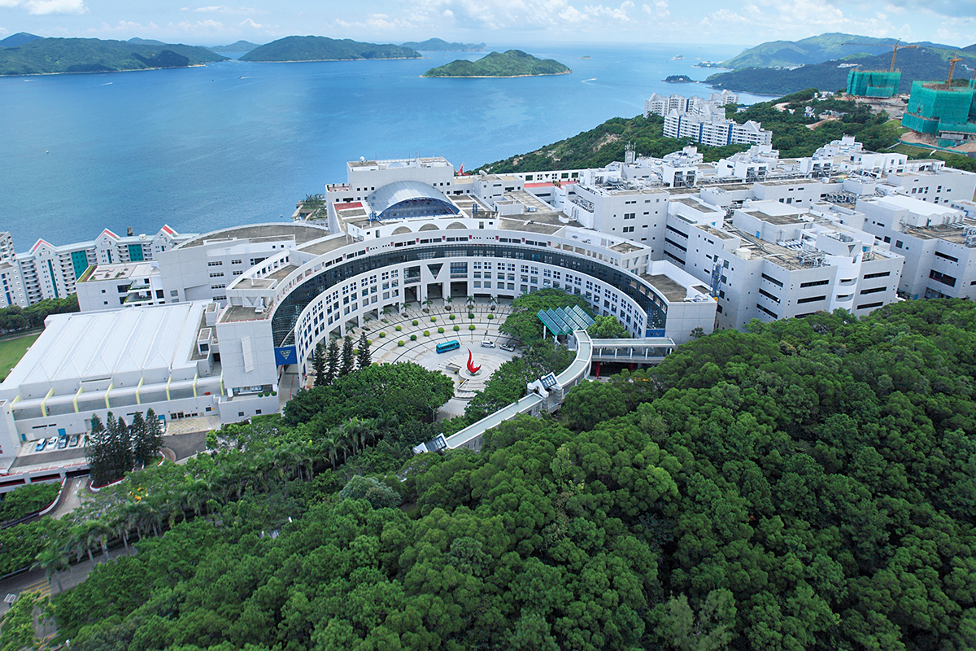
CONTENT
1
Recommendation System
2
Data
3
Problems
4
Deep models
5
Do recommendation
6
Conclusion
Notes:
I will briefly talk about the recommendation system and introduce the dataset we use. And then talk about the problems of some algorithnms and finally talk about the our plans and expectations.

Slide 3

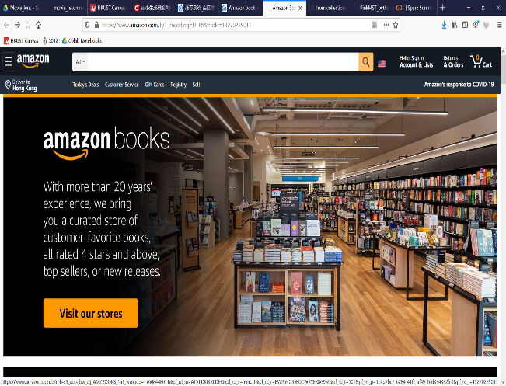

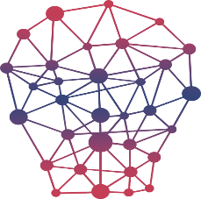
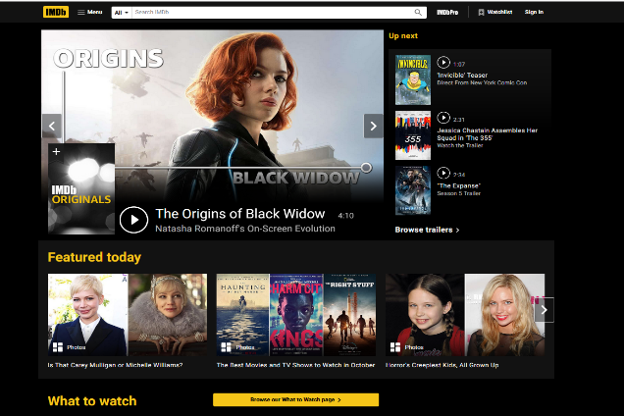
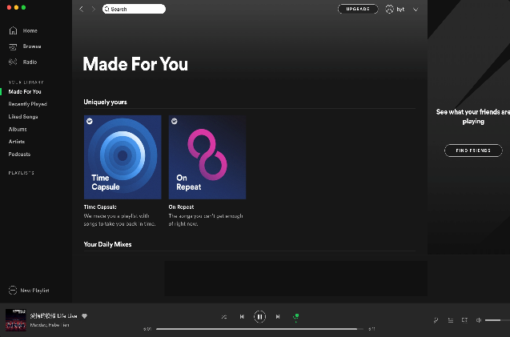

Recommendation System
BOOK
VIDEO
MOVIE
MUSIC
Notes:
As we can see, nowadays, recommendation systems can be seen nearly everywhere.
I think most of us may be familiar with tiktok video recommendation.and what we want todo isto implement a movie recommendation system.

Slide 4
CONTENT
1
Recommendation System
2
Data
3
Problems
4
Deep models
5
Do recommendation
6
Conclusion
Notes:
I will briefly talk about the recommendation system and introduce the dataset we use. And then talk about the problems of some algorithnms and finally talk about the our plans and expectations.

Slide 5
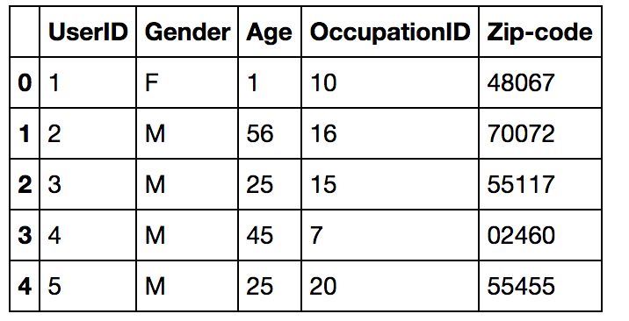
Dataset
Movielens 1M: https://grouplens.org/datasets/ movielens/
user-data
1: "Under 18"
18: "18-24"
25: "25-34"
35: "35-44"
45: "45-49"
50: "50-55"
56: "56+"
gender: from’F’&’M’ to 0&1
age: transform to continuous numbers 0 to 6
Notes:
We choose the movielens dataset. It contains 1 million reviews from 6000 users on nearly 4000 movies.
There are there datasets. User-data movie-data rating-data. User-data contains side information about users movie-data contains side information about movies titles and genres . The rating dataset is the most important data. We use this data to predict the missing scores.

Slide 6
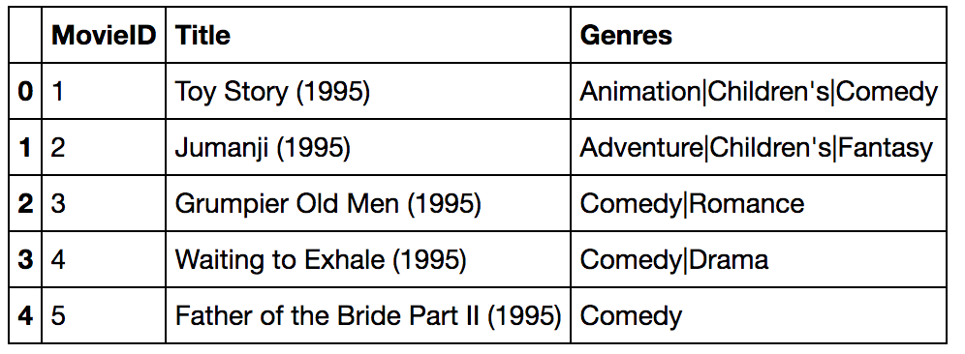
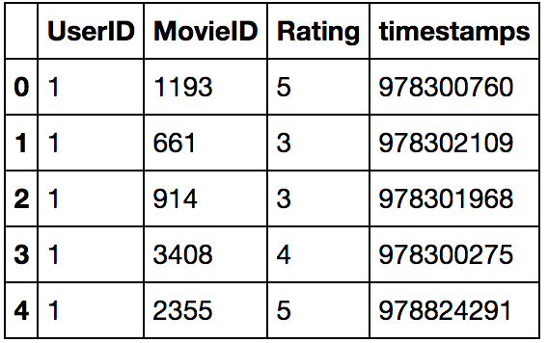
movie-data
title & genres: set up a dictionary from text & labels to numbers
rating-data

Slide 7
CONTENT
1
Recommendation System
2
Data
3
Problems
4
Deep models
5
Do recommendation
6
Conclusion
Notes:
I will briefly talk about the recommendation system and introduce the dataset we use. And then talk about the problems of some algorithnms and finally talk about the our plans and expectations.

Slide 8

Problems
 | Item 1 | Item 2 | Item 3 | Item 4 | Item 5 | Item 6
User 1 | 4 | 3 |  |  | 5
User 2 | 5 |  | 4 |  | 4
User 3 | 4 |  | 5 | 3 | 4
User 4 |  | 3 |  |  |  | 5
User 5
User 6 |  |  | 2 | 4 |  | 5
Collaborative Filtering
user-based
item-based
Still has some Cons
Cold-start
Notes:
we know that Collaborative Filtering is a very famous and common method for recommendation.there are item-based and item based CF.but CF suffers from many challenges, for instances, cold-start problem. we can see that it is a sparse matrix,it is hard to recommend movies to user5.

Slide 9
CONTENT
1
Recommendation System
2
Data
3
Problems
4
Deep models
5
Do recommendation
6
Conclusion
Notes:
I will briefly talk about the recommendation system and introduce the dataset we use. And then talk about the problems of some algorithnms and finally talk about the our plans and expectations.

Slide 10
Deep Models
Auto-Encoder
Variational-Auto-Encoder
TextCNN-based
Use CNN to extract features from titles of the movies
BERT-based
Use BERT to extract features
Notes:
Then I will talk about our plans and expectations. We will use textcnn-based model to extract features from titles of movies and find a way to concatenate the user info and movie info. And we will use sentence-bert to substitute the textcnn.

Slide 11
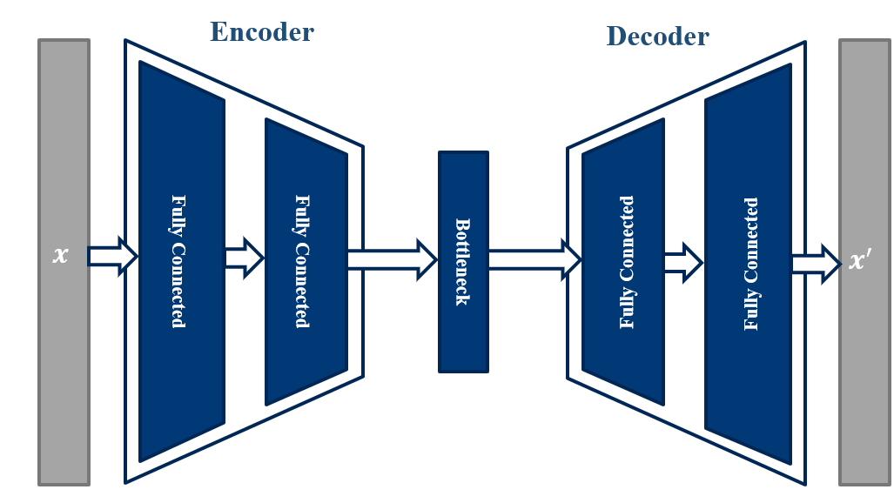
Auto-Encoder
loss = batch MSE
batch
batch
batch
batch
1
2
3
nan
2
nan
nan
nan
4
5
1
nan
1
2
3
0
2
0
0
0
4
5
1
0
0.9
2.7
3.8
0.2
2.9
1.7
0.3
0.5
4.9
4.6
1.3
0.3
0.9
2.7
3.8
0
2.9
0
0.
0
4.9
4.6
1.3
0
mask nan with 0
auto encoder
remask
Notes:
And my inspiration comes from a paper on AAAI. The ctrip team add some additional information to stacked denoising auto-encoder. Later I will try to add side information to VAE and DAE and make a better model.

Slide 12
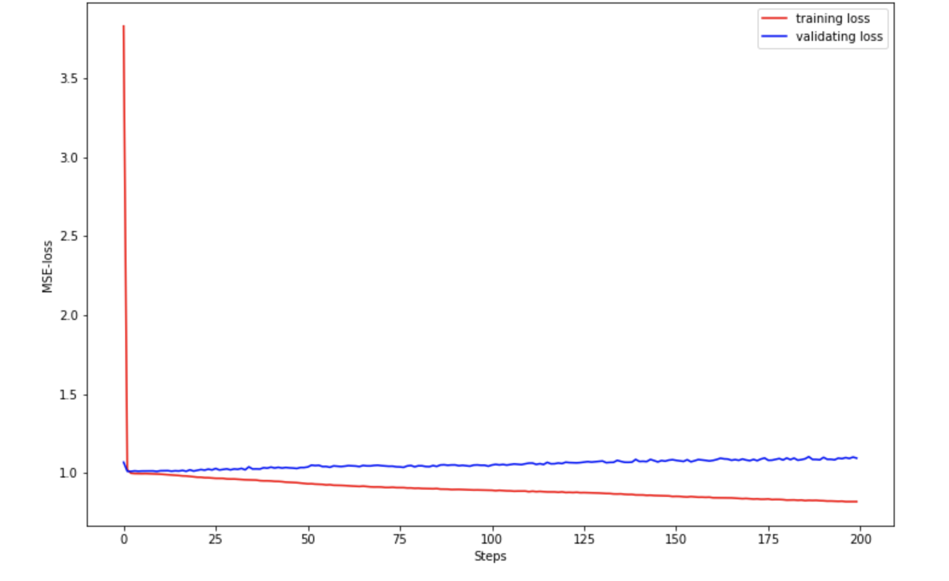
Auto-Encoder
Notes:
And my inspiration comes from a paper on AAAI. The ctrip team add some additional information to stacked denoising auto-encoder. Later I will try to add side information to VAE and DAE and make a better model.

Slide 13
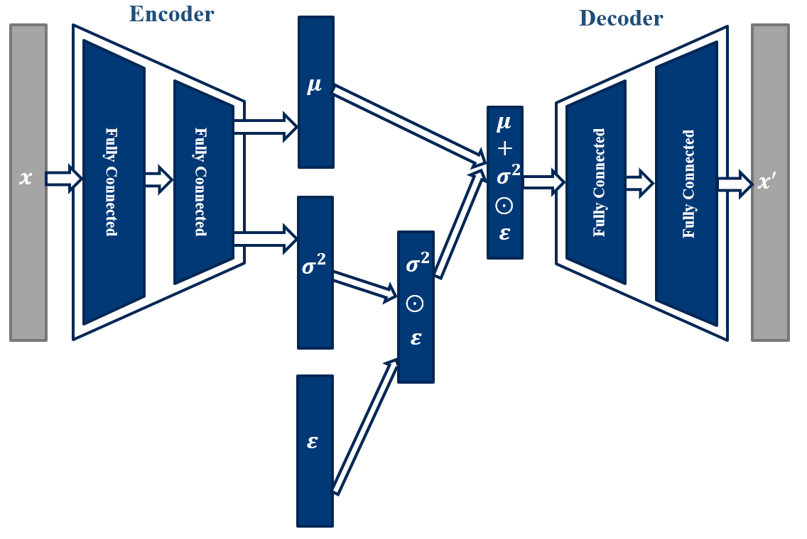
Variational-Auto-Encoder
loss = MSE + KL-divergence
Notes:
And my inspiration comes from a paper on AAAI. The ctrip team add some additional information to stacked denoising auto-encoder. Later I will try to add side information to VAE and DAE and make a better model.

Slide 14
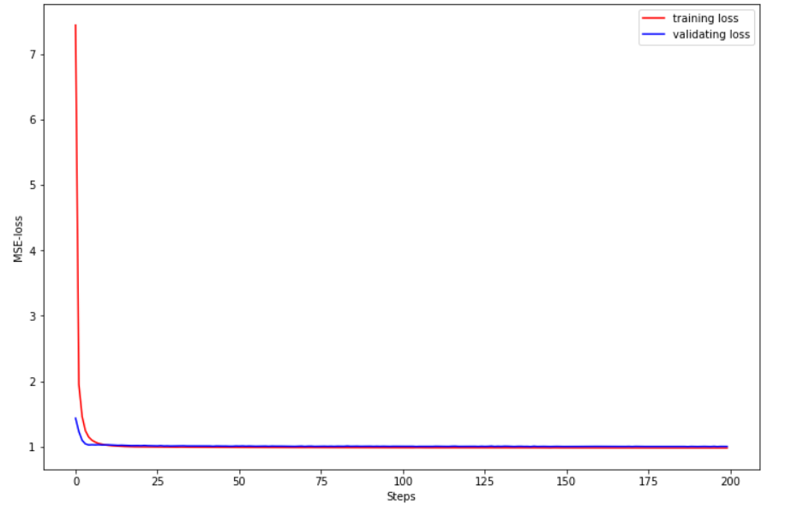
Variational-Auto-Encoder
Notes:
And my inspiration comes from a paper on AAAI. The ctrip team add some additional information to stacked denoising auto-encoder. Later I will try to add side information to VAE and DAE and make a better model.

Slide 15
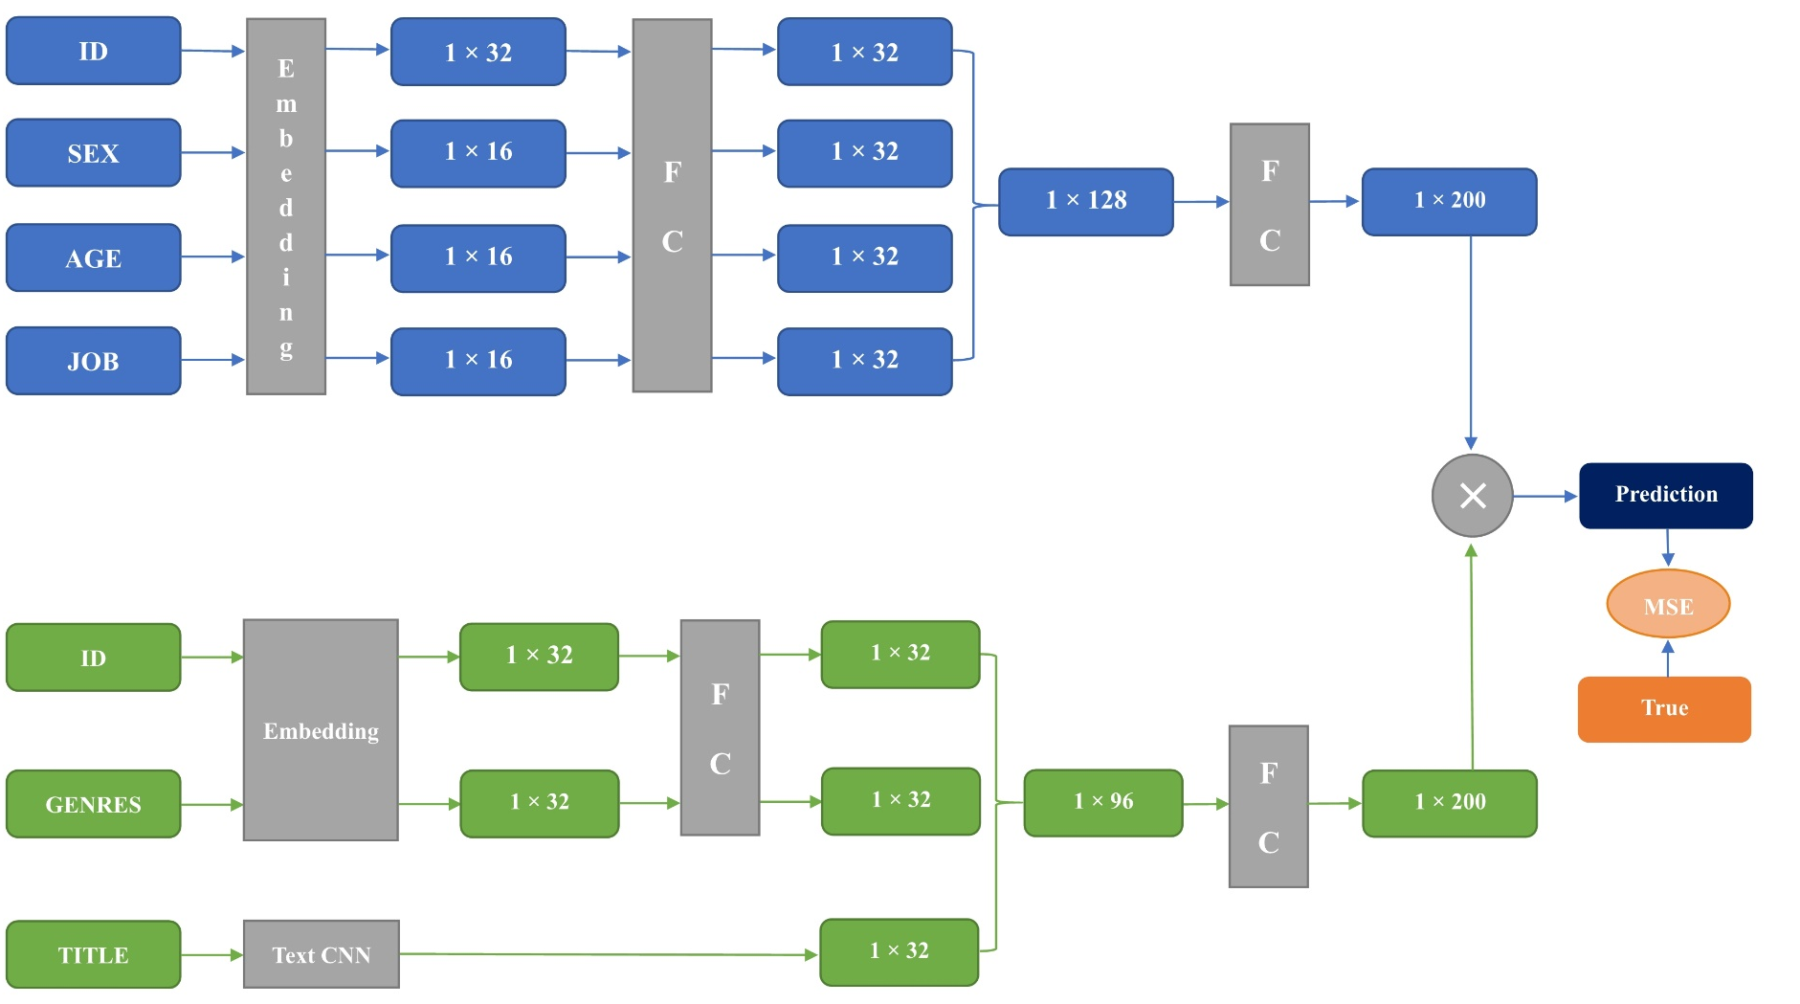
TextCNN-based
Notes:
actually we have done some experiments. this is our Neural Networks architectures . we have train the model and and have made some improvements.

Slide 16
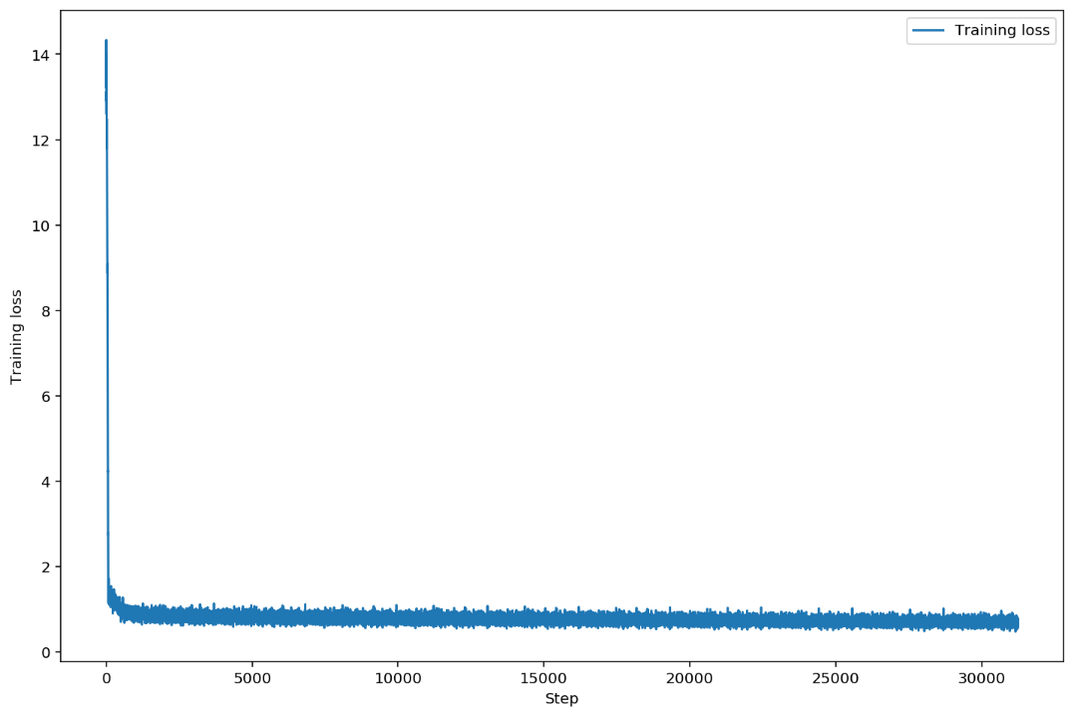
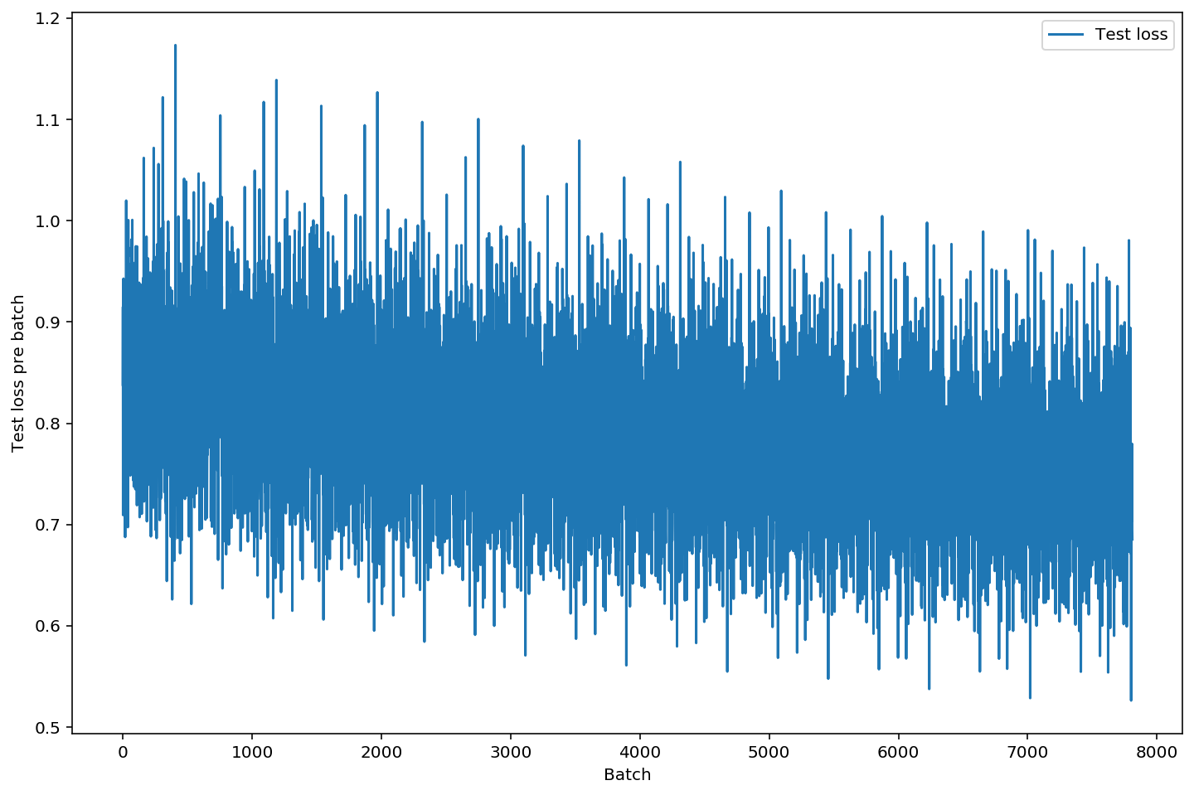
TextCNN-based
Training loss
Test loss
Notes:
And my inspiration comes from a paper on AAAI. The ctrip team add some additional information to stacked denoising auto-encoder. Later I will try to add side information to VAE and DAE and make a better model.

Slide 17
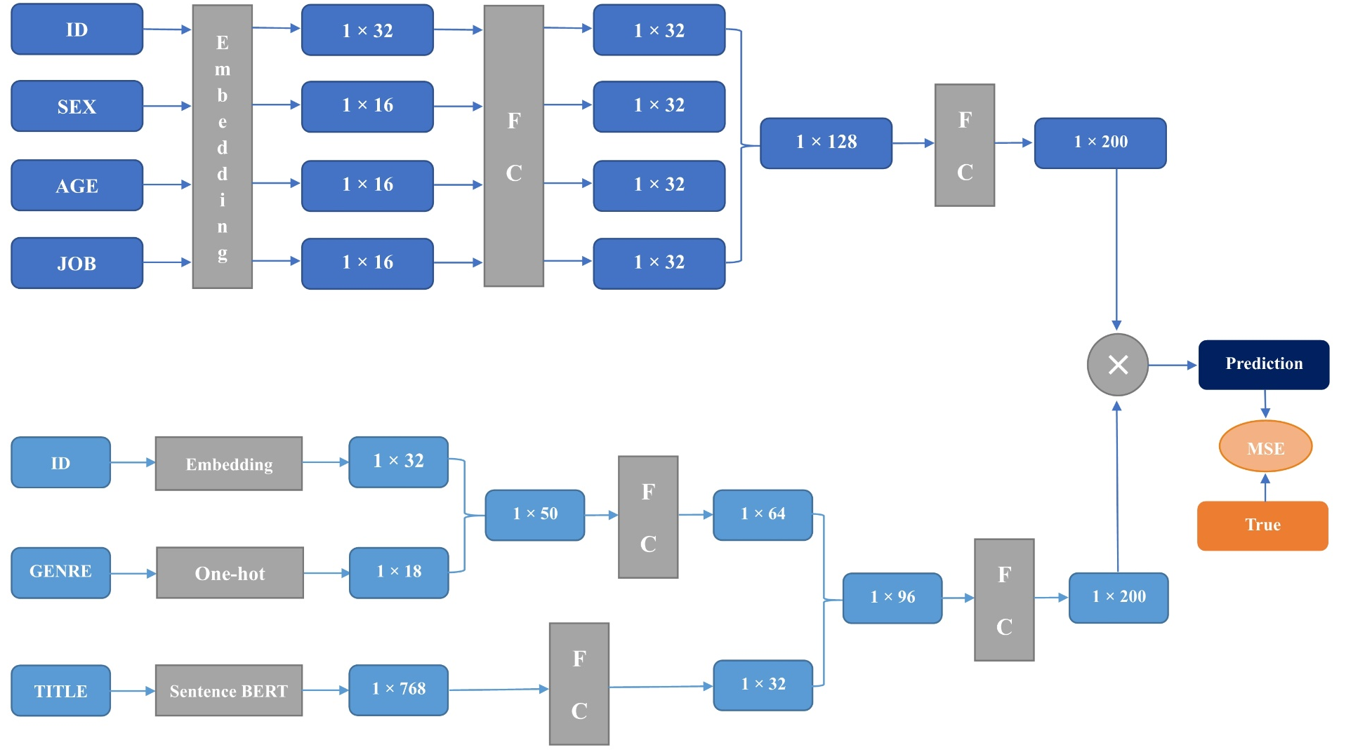
BERT-based
Notes:
And this is bert-bsed model. And I will not talk much about our model. If you want to. Know more about our model you can raise the questions later and yuxin will answer the questions.

Slide 18
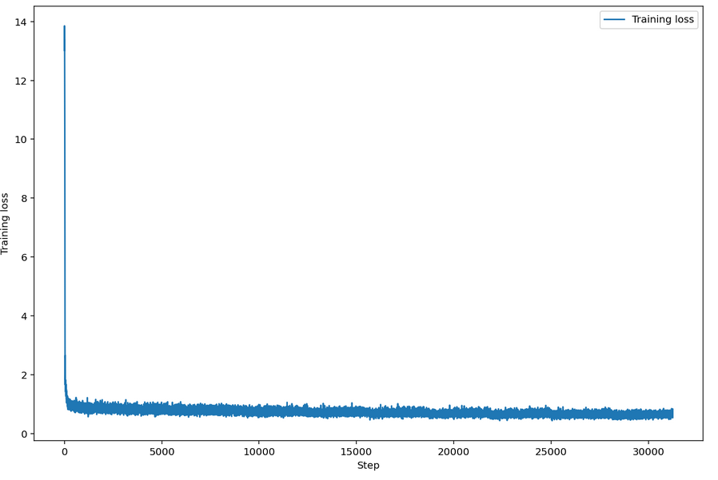
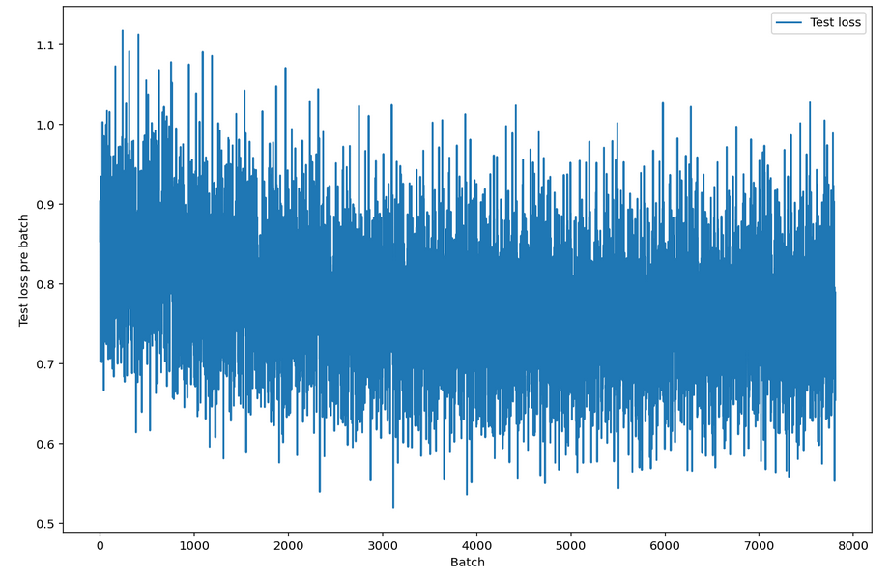
BERT-based
Training loss
Test loss
Notes:
And my inspiration comes from a paper on AAAI. The ctrip team add some additional information to stacked denoising auto-encoder. Later I will try to add side information to VAE and DAE and make a better model.

Slide 19
Comparison between models
Model | Test MSE
Item-based * | 3.4010
User-based * | 3.1431
SVD * | 2.4416
Auto-Encoder | 0.9873
Variational-Auto-Encoder | 0.9863
Text-CNN-based | 0.7521
BERT-based | 0.7507
* means referenced from https://www.cnblogs.com/lqerio/p/11193471.html
Notes:
And my inspiration comes from a paper on AAAI. The ctrip team add some additional information to stacked denoising auto-encoder. Later I will try to add side information to VAE and DAE and make a better model.

Slide 20
CONTENT
1
Recommendation System
2
Data
3
Problems
4
Deep models
5
Do recommendation
6
Conclusion
Notes:
I will briefly talk about the recommendation system and introduce the dataset we use. And then talk about the problems of some algorithnms and finally talk about the our plans and expectations.

Slide 21
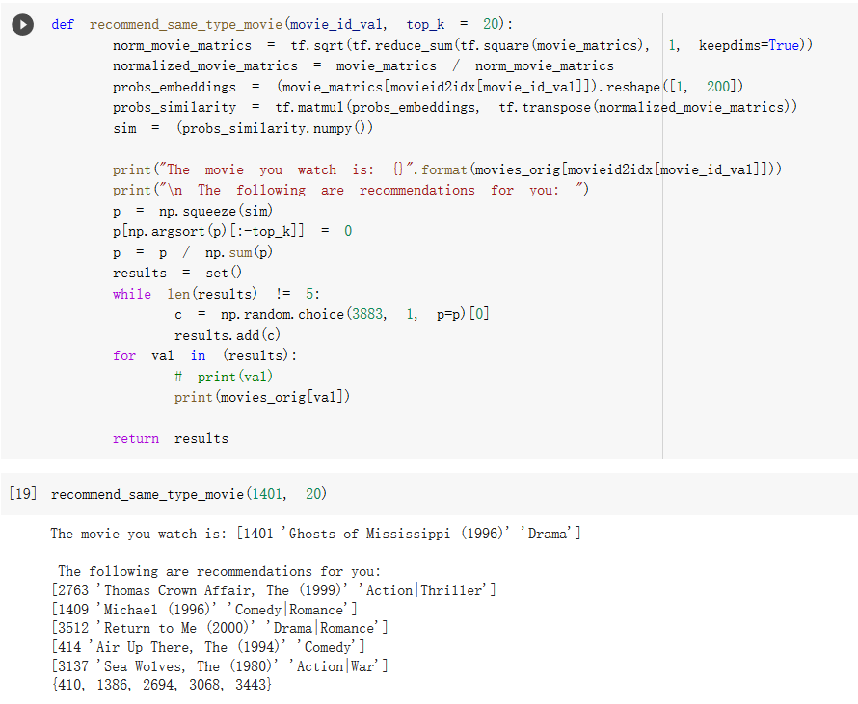
Recommend movies of the same type
Notes:
思路是计算当前看的电影特征向量与整个电影特征矩阵的余弦相似度，取相似度最大的top_k个，这里加了些随机选择在里面，保证每次的推荐稍稍有些不同。

Slide 22
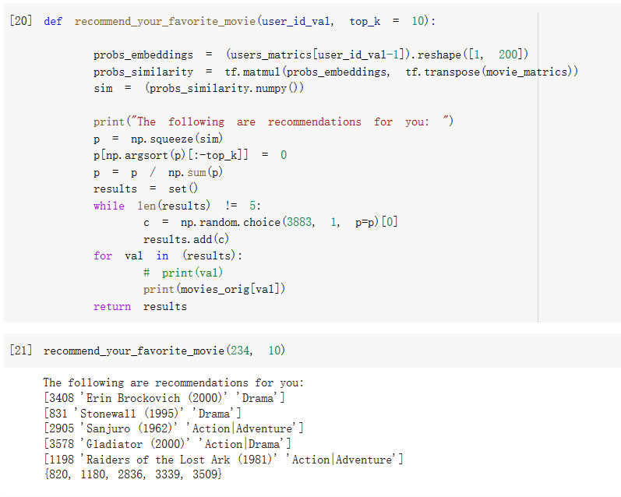
Recommend movies that users like
Notes:
思路是使用用户特征向量与电影特征矩阵计算所有电影的评分，取评分最高的top_k个，同样加了些随机选择部分。

Slide 23
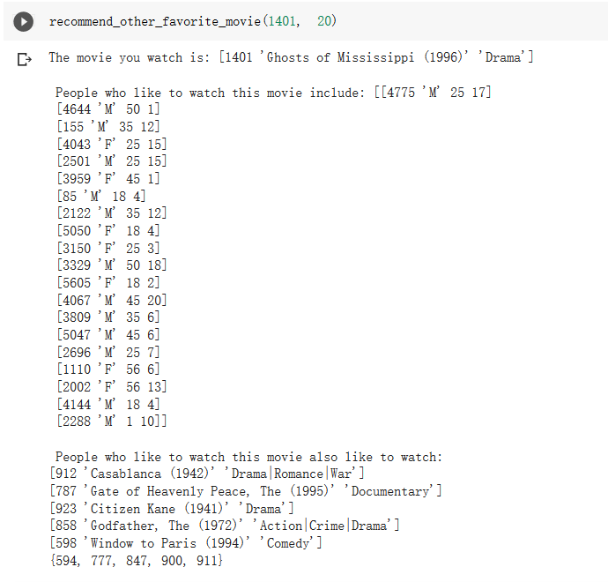
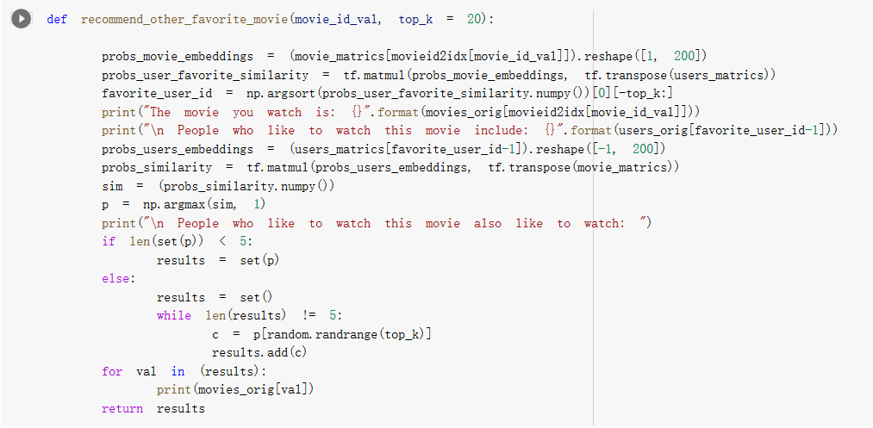
Recommend other movies liked by users who have watched this movie
Notes:
And my inspiration comes from a paper on AAAI. The ctrip team add some additional information to stacked denoising auto-encoder. Later I will try to add side information to VAE and DAE and make a better model.

Slide 24
CONTENT
1
Recommendation System
2
Data
3
Problems
4
Deep models
5
Do recommendation
6
Conclusion
Notes:
I will briefly talk about the recommendation system and introduce the dataset we use. And then talk about the problems of some algorithnms and finally talk about the our plans and expectations.

Slide 25
What we have done
Use deep learning methods to complete the rating matrix
Minimize MSE between our predictions and true values
Solve or smooth the cold-start problem
Improve the quality of recommendation
Notes:
to sum up,
what we want to do is Use deep learning methods to complete the rating matrix Minimize MSE between our predictions and true values
Solve or smooth the cold-start problem
we will try to improve the quality of recommendation .

Slide 26
Thanks for your listening！

